Slide 1
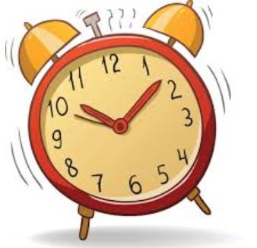
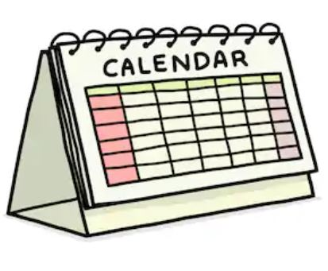
Date and Time Data Types and Tools
161FA04200
161FA04191
161FA04192

Slide 2
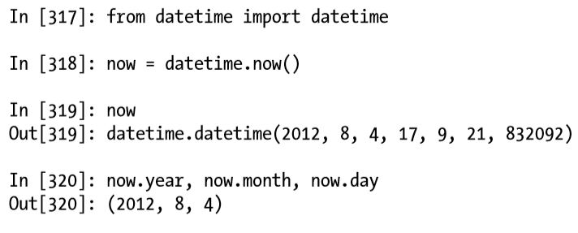
Introduction
The Python standard library includes data types for date and time data, as well as calendar-related functionality.
The datetime.datetime type, or simply datetime, is widely used.

Slide 3
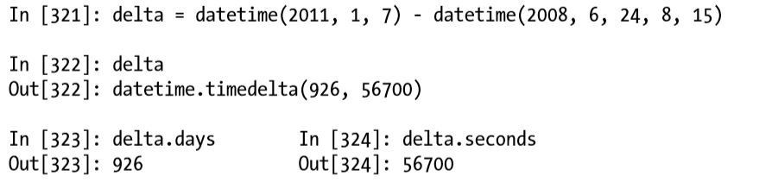
datetime
“datetime” stores both the date and time down to the microsecond. “datetime.time delta” represents the temporal difference between two datetime objects.

Slide 4
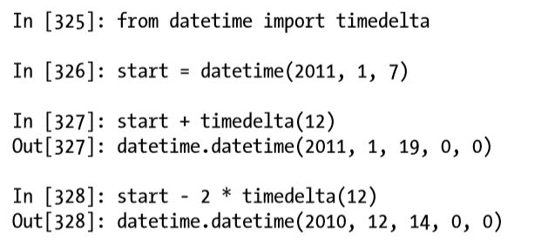
Operations
You can add (or subtract) a timedelta or multiple there of to a datetime object to yield a new shifted object.

Slide 5
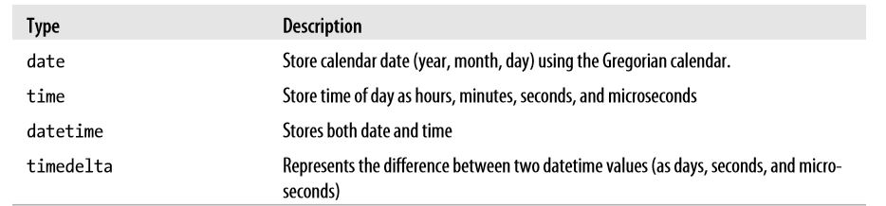
Cont...
The data types in the datetime module are:

Slide 6
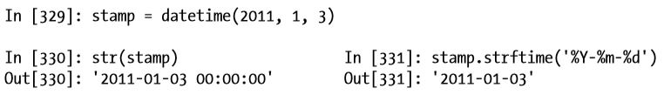
Converting between “string” and “datetime”
datetime objects and pandas Timestamp objects can be formatted as strings using ‘str’ or the ‘strftime’ method by passing a format specification.

Slide 7
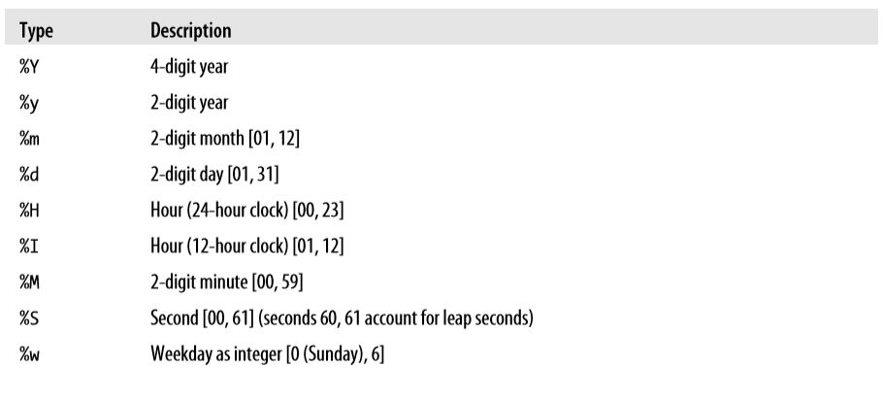
Format codes
The list of format codes are:

Slide 8
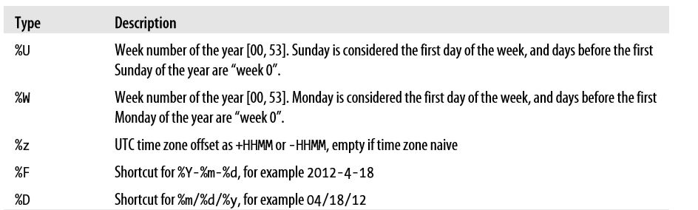
Cont...

Slide 9
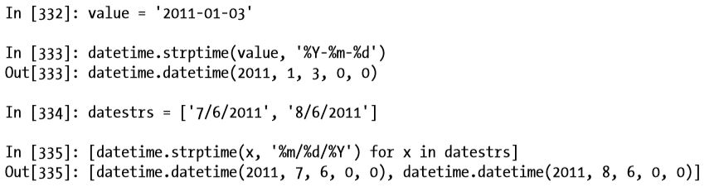
Parsing date from string
“datetime.strptime” is the best way to parse a date with a known format.
These same format codes can be used to convert strings to dates using datetime.strptime.

Slide 10
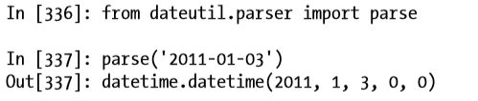
parse method
It can be a bit annoying to have to write a format specification each time, especially for common date formats. In this case, you can use the “parser.parse” method in the third party “dateutil” package.

Slide 11

Cont...
parse method of dateutil package is capable of parsing the date even it is specified in any format.

Slide 12

Cont...
Generally use the datetime we are representing as ‘yyyy-mm-dd’ format.
In order to display the date before the month i.e as ‘yyyy-dd-mm’ format we will use ‘dayfirst’ attribute of ‘parse’ method.

Slide 13
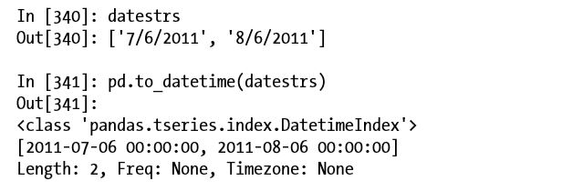
to_datetime method
In pandas we can work with array of dates.
“to_datetime” method parses many different kinds of date representations.

Slide 14
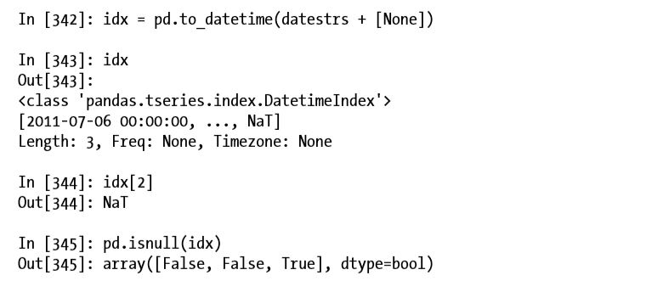
Cont...
It also handles values that should be considered missing (None, empty string, etc.).
NaT (Not a Time) is pandas’s NA value for timestamp data.

Slide 15
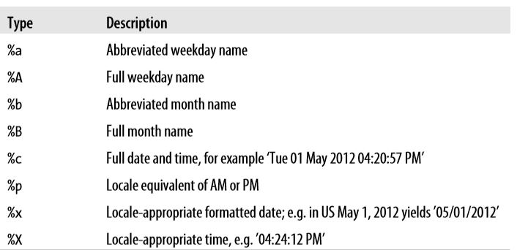
Cont...
datetime objects also have a number of locale-specific formatting options for systems in other countries or languages. For example, the abbreviated month names will be different on German or French systems compared with English systems.

Slide 16
THANK YOU

